Slide 1


Self-check 2 Look Back 2
UNIT 2

Slide 2

Revise your film vocabulary with this quiz!
https://wordwall.net/play/7672/877/785

Slide 3
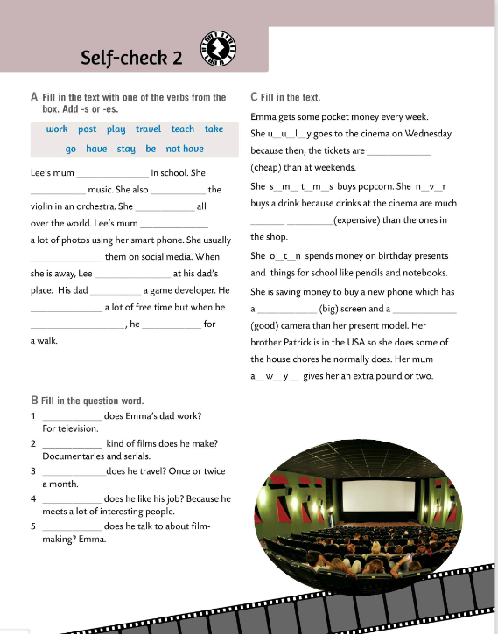
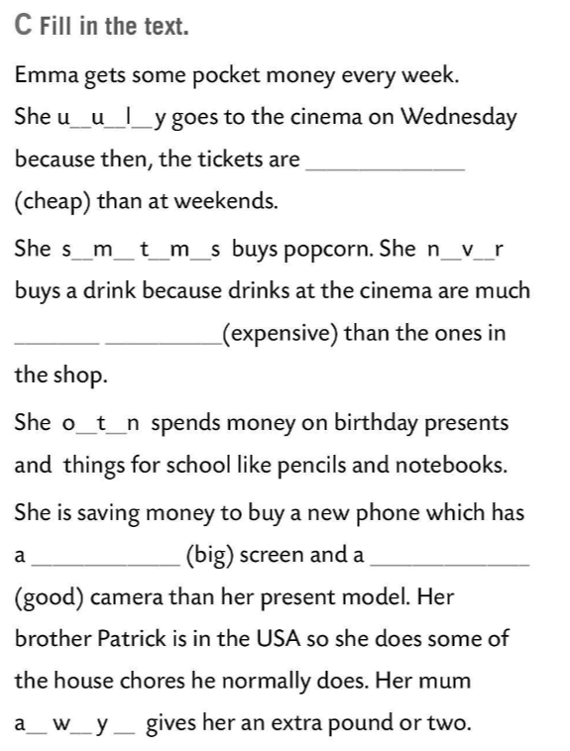
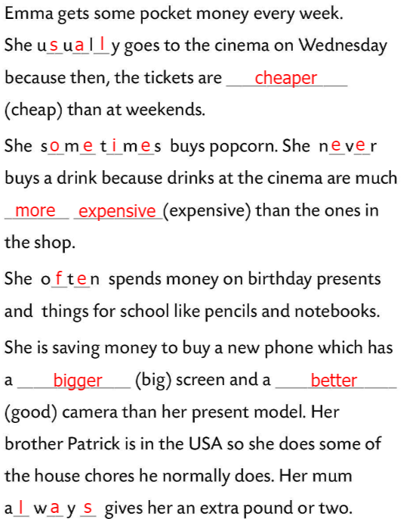
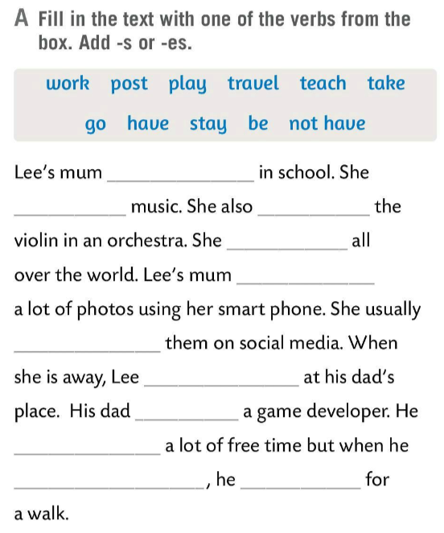
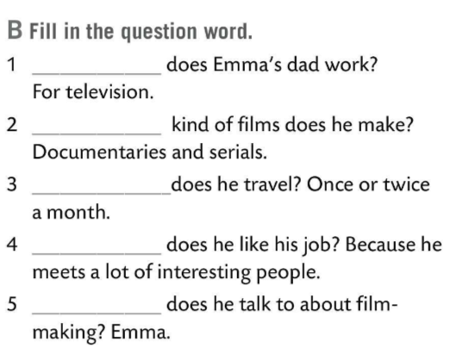
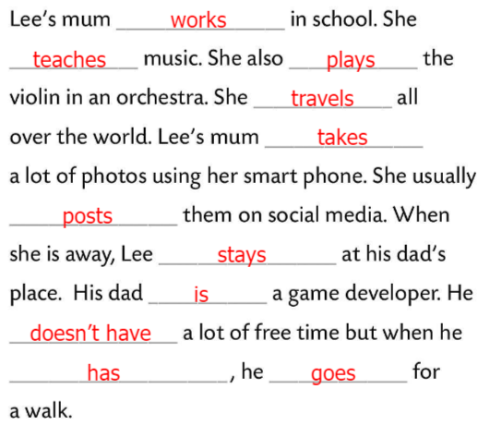
Fill in the text in Task A with one of the verbs from the box. Add –s or –es.
Check.
Where
Fill in the question word in Task B.
What
Check.
How often
Fill in the text in Task C.
Why
Who
Check.

Slide 4
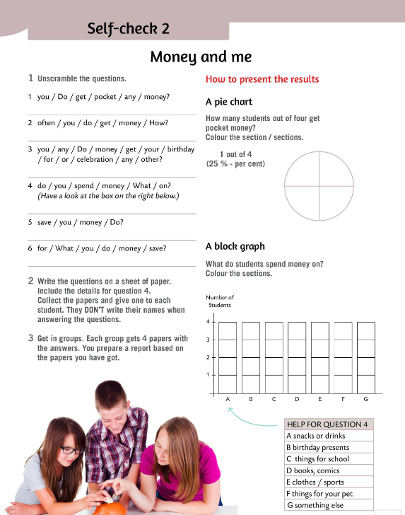
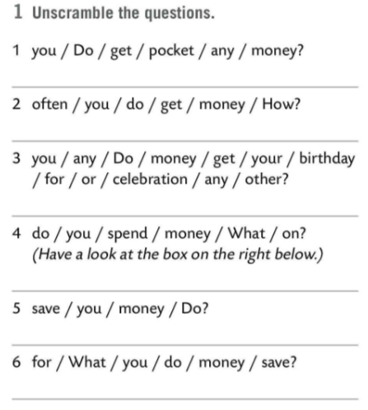
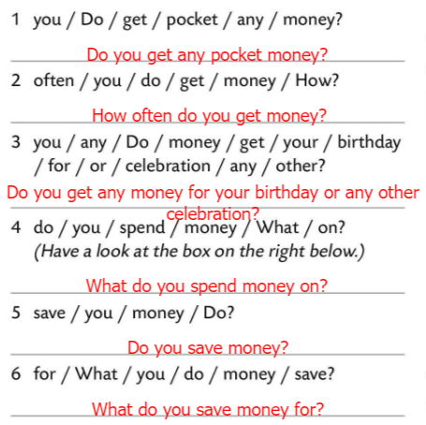
Unscramble the questions in Task 1.
Check.
Students write the answers on a sheet of paper without names.
Teacher collects all answers and shuffle.
Get in groups. Each group gets 4 papers with the answers.
Prepare a report based on the papers you have got.

Slide 5
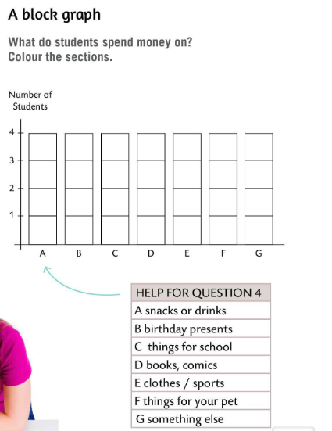
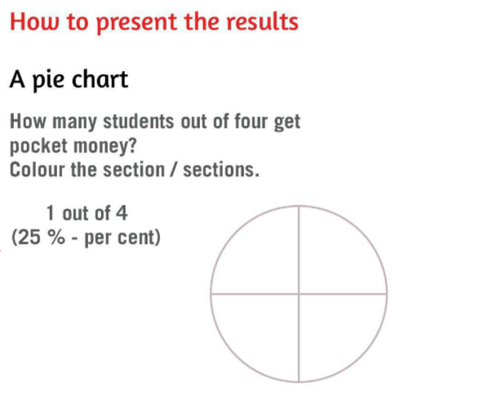
You can present the results with a pie chart.
How many students out of four get pocket money? Colour the section/sections and calculate the percentage.
Present the answers for question 4. Draw a graph and colour the sections.

Slide 6
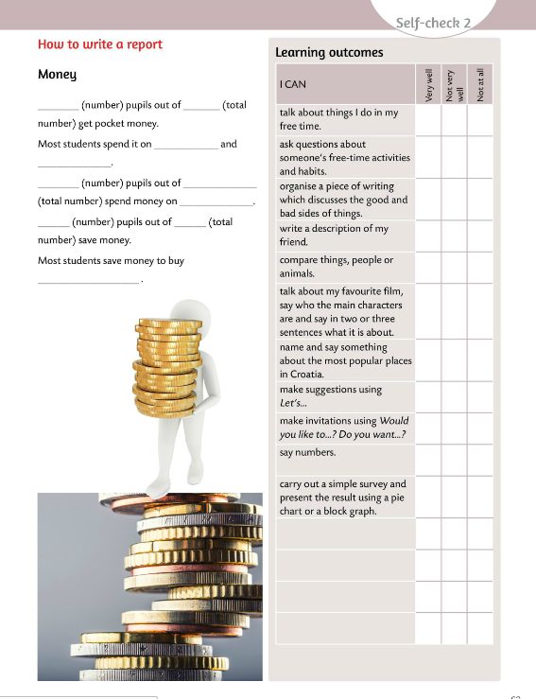
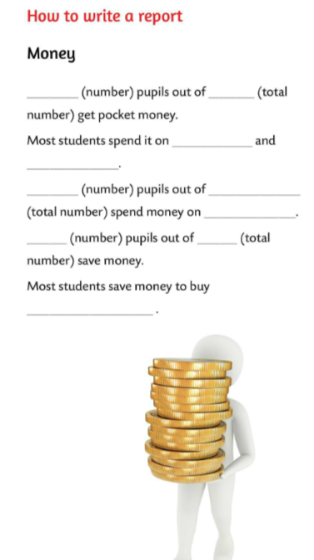
Write a report. Fill in the sentences with the values you got from the survey.
Report back to your classmates.

Slide 7
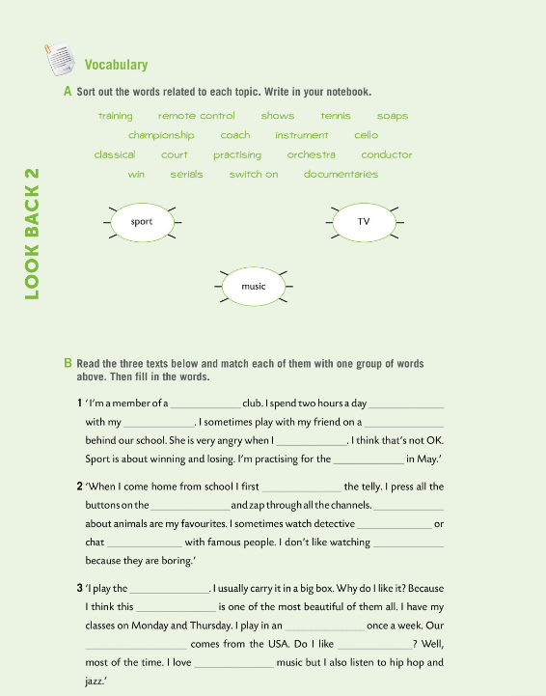

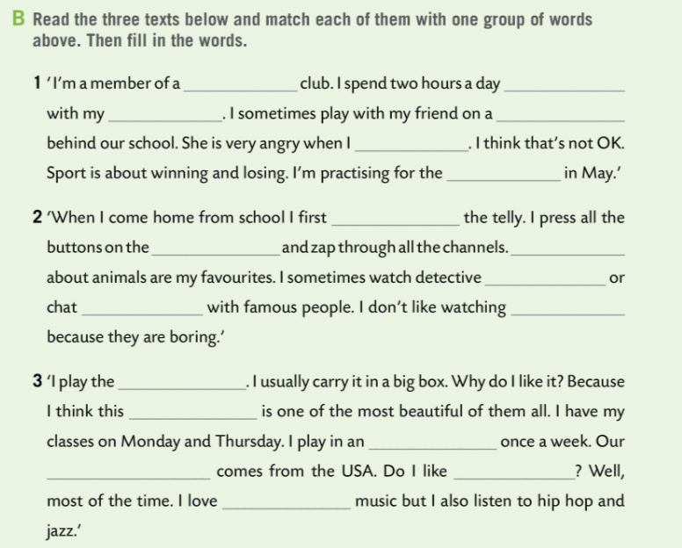
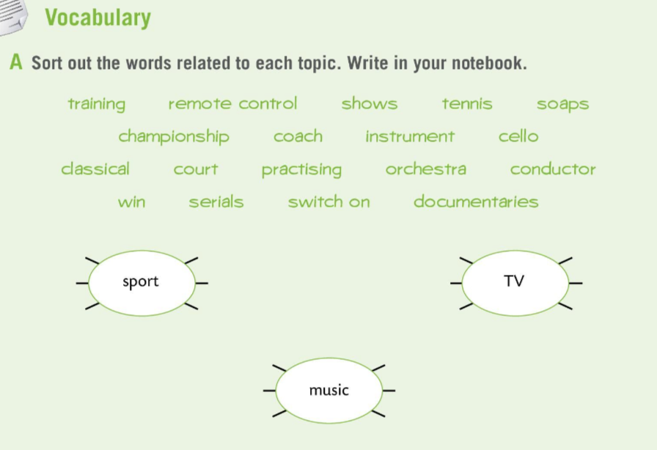
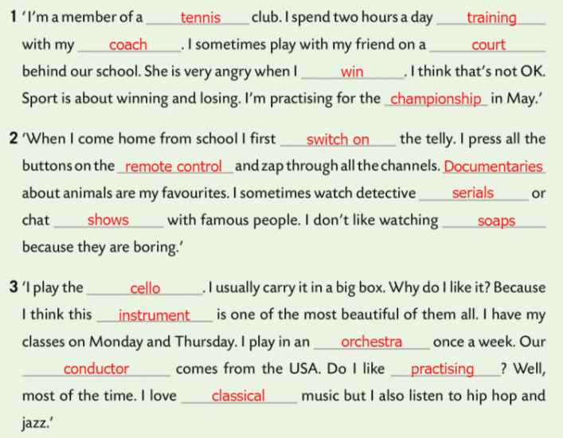
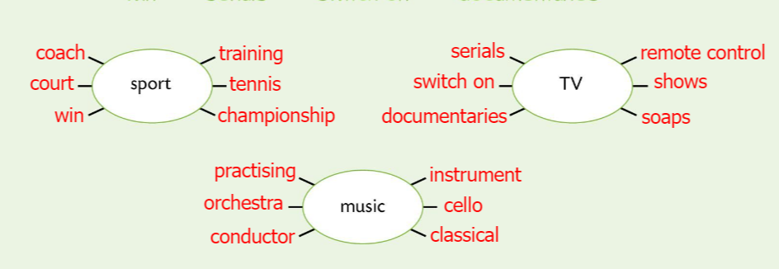
Workbook, page 54. LOOK BACK 2
Sort out the words in Task A related to each topic.
Write in your notebook.
Check.
Read the three texts in Task B and match each of them with one group of words above.
Then fill in the words.
Check.

Slide 8
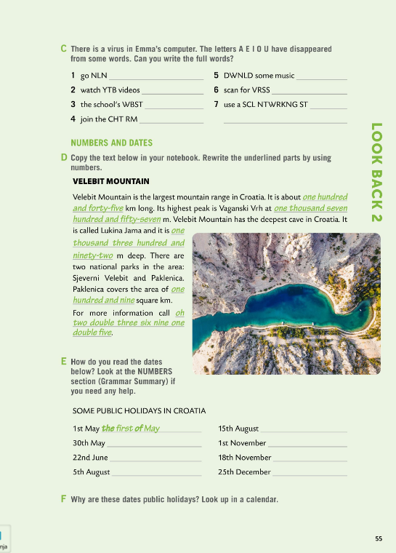
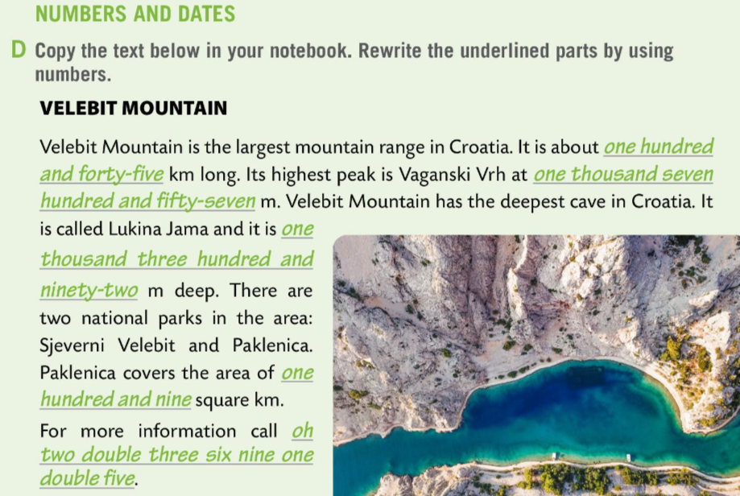
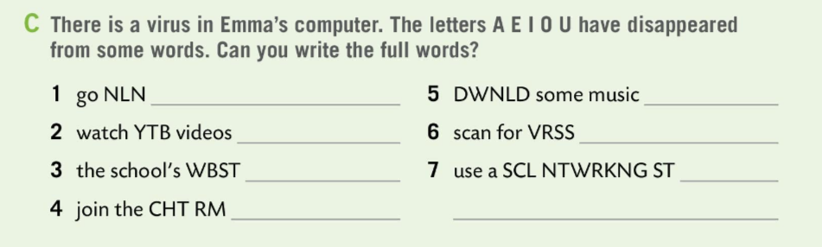
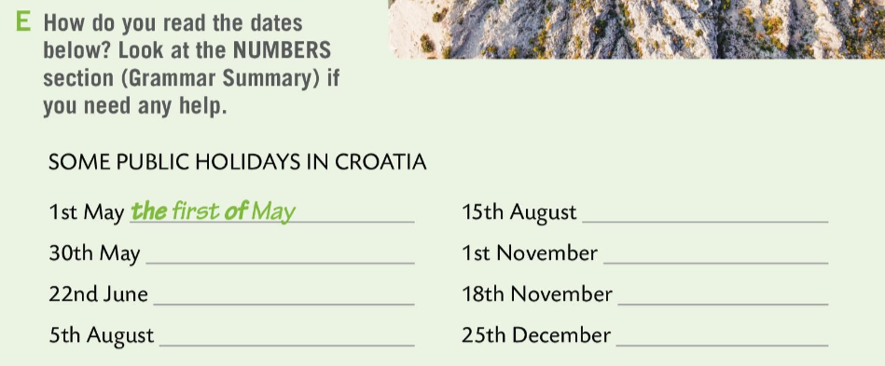
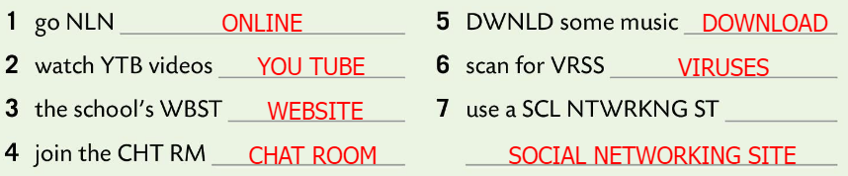
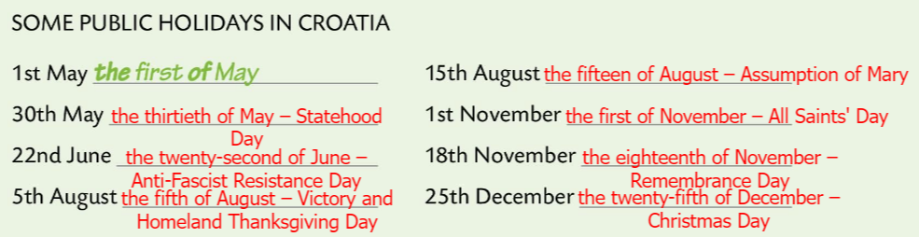
Workbook, page 55. LOOK BACK 2
There is a virus in Emma’s computer. The letters A E I O U have disappeared from some words. Can you write the full words in Task C?
145
Check.
1757
Copy the text below in your notebook. Rewrite the underlined parts by using numbers.
1392
109
Check.
How do you read the dates in Task E?
023369155
Check.

Slide 9
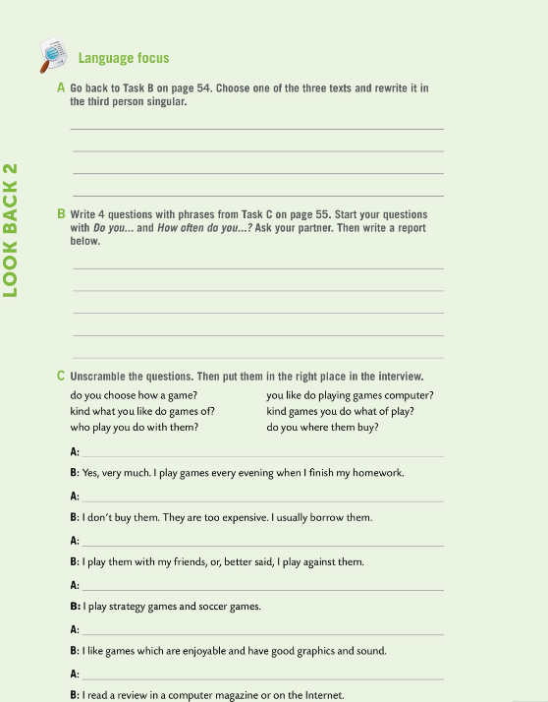
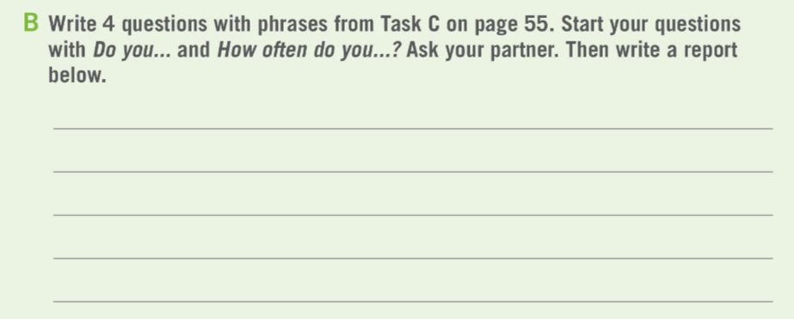
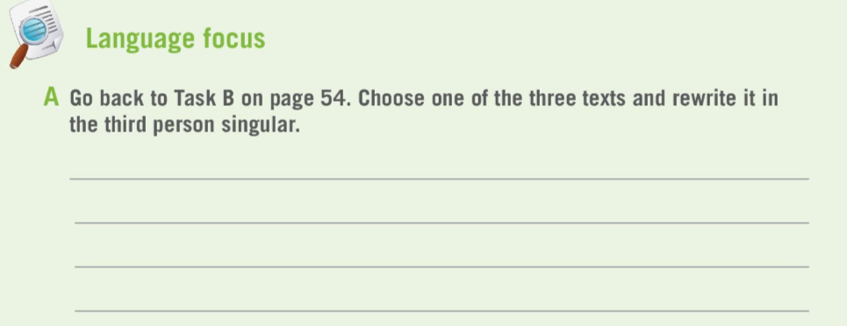
Workbook, page 56. LOOK BACK 2
Go back to Task B on page 54. Choose one of the three texts and rewrite it in the third person singular.
Check.
Write 4 questions with phrases from Task C on page 55.
Start your questions with Do you… and How often do you…?
Ask your partner. Then write a report below.
Share your report with the class.

Slide 10
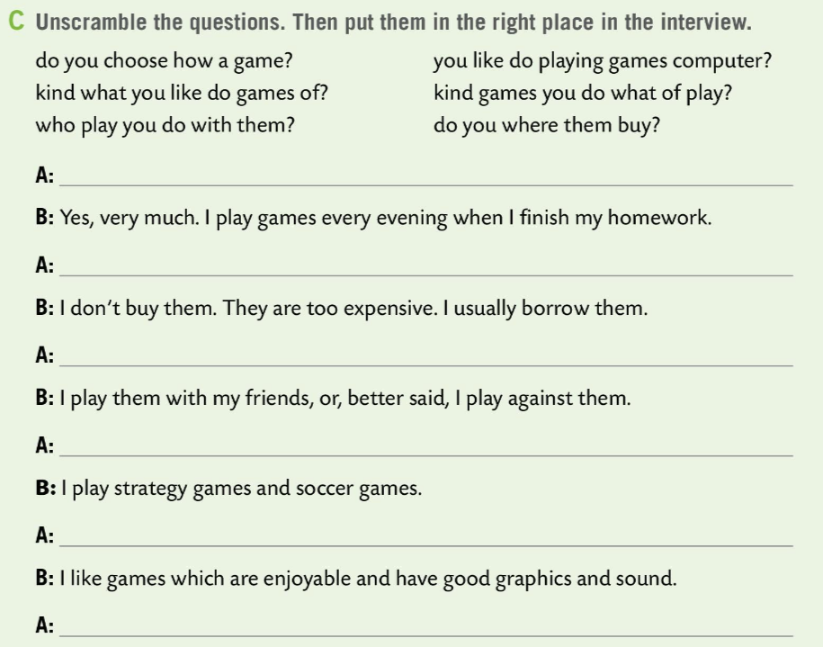
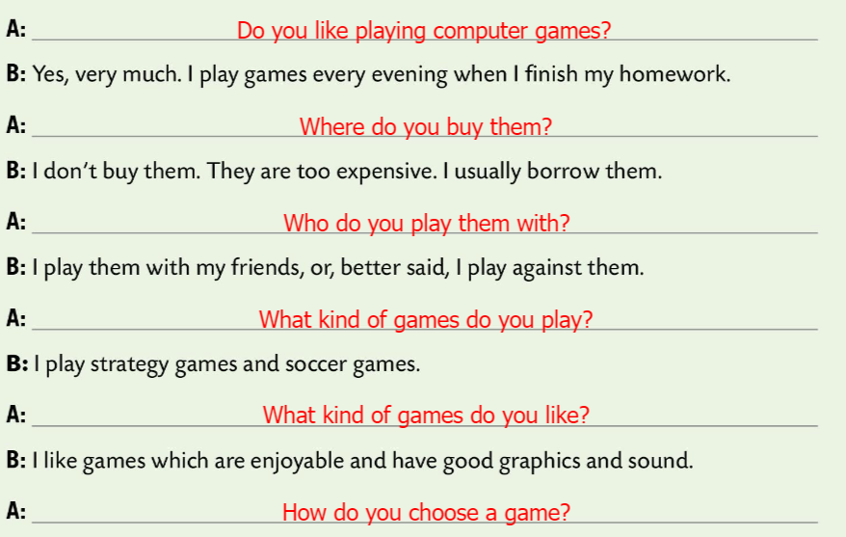
Workbook, page 56. LOOK BACK 2
Unscramble the questions in Task C. Then put them in the right place in the interview.
Check.

Slide 11
Workbook, page 57. LOOK BACK 2
Unscramble the questions in Task C. Then put them in the right place in the interview.
Check.

Slide 12
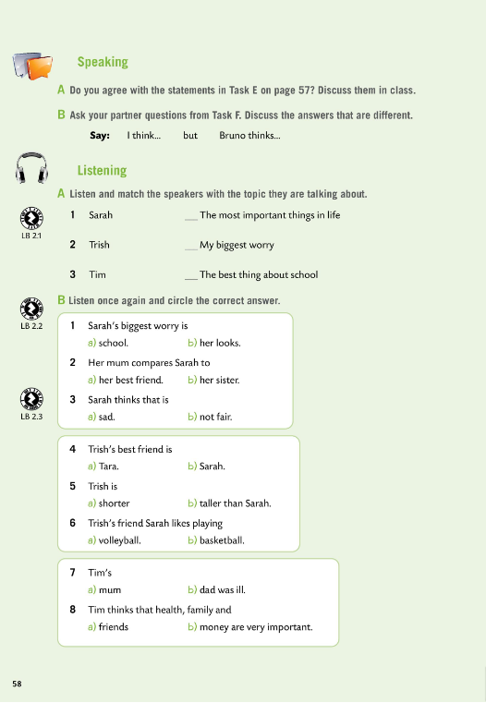
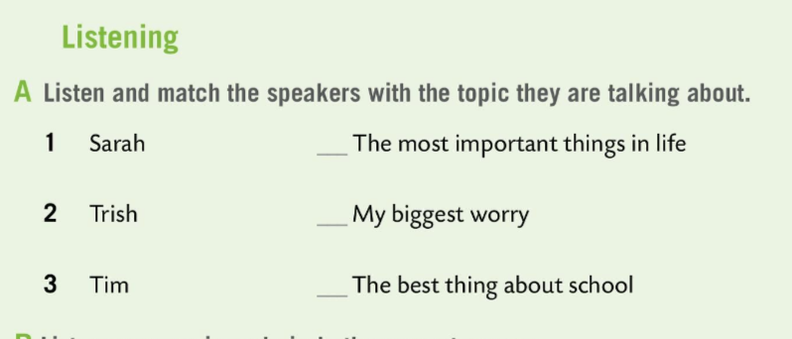
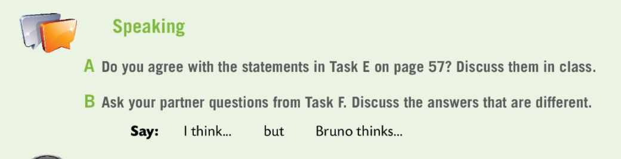

Workbook, page 58. LOOK BACK 2
Do you agree with the statements in Task E on page 57?
Ask your partner questions from Task F.
Discuss the answers that are different.
3
2
Listen and match.
1
Check.

Slide 13
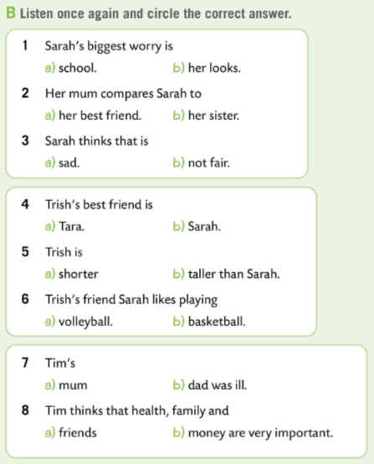
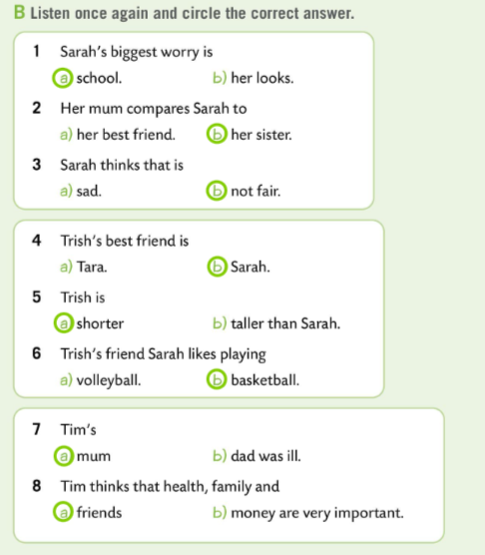
Workbook, page 58. LOOK BACK 2
Listen once again and circle the correct answer.
Check.

Slide 14
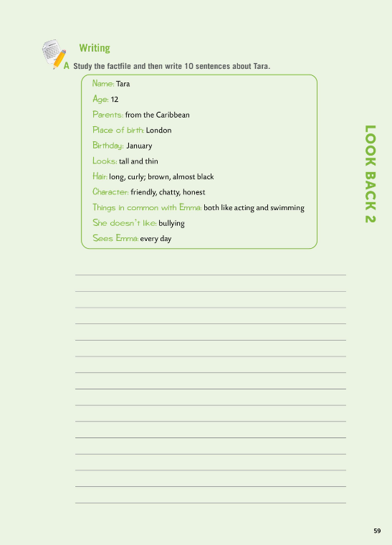
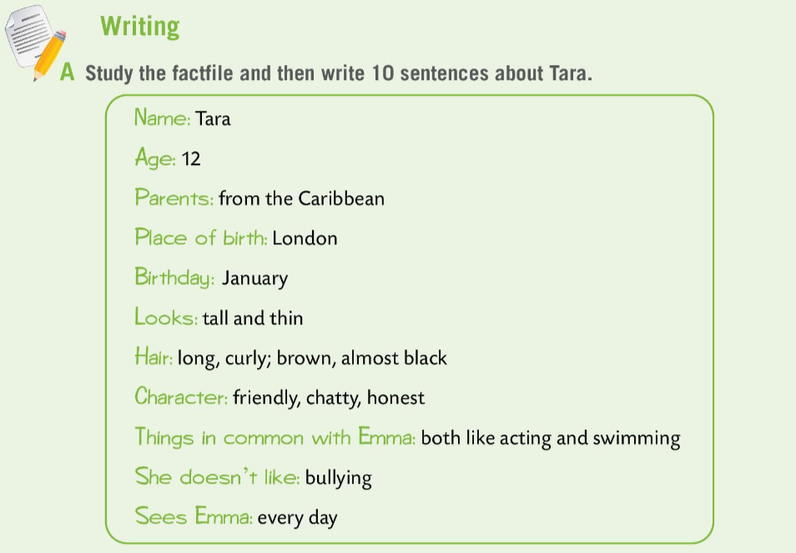
Workbook, page 59. LOOK BACK 2
Study the factfile and then write 10 sentences about Tara.
Read your sentences to the class.

Slide 15
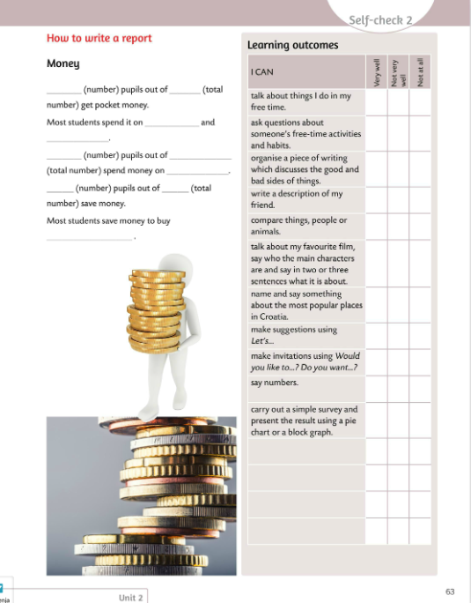
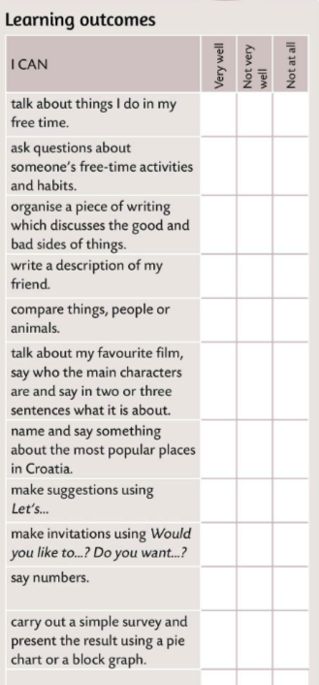

Look at the learning outcomes table.
Which of the outcomes did you master very well?
Which ones need more improvement?
Do you need more time and practice for any of them?
Be honest.

